Slide 1



TABISH FEHRI
Working: ADVANCED FIRE & SAFETY
BY ANKIT SINGH

Slide 2
CONTENT

Slide 3
About US
Advanced Fire & Safety is one of the fastest growing company in the field of fire, safety, Rescue and disaster management equipment manufacturing and fabrication of fire fighting vehicles.
AFS is moving towards design and Fabricating the best possible fire protection, suppression and training systems for our State Fire Services, Defence services and exports. We are constantly innovating and expanding our services to meet the needs of our country at par with international standard.
At AFS our motto is to provide most updated and reliable system to combat fire hazards and rescue equipment. Our belief is to build an everlasting association with our partners to help improvise and deliver only the best.
Our company specializes in the manufacturing of vide ranges of high- and low-pressure water mist and CAFS based system used for fire fighting at very less water in comparison to our existing conventional systems. Our innovation to upgrade and indigenise instant fire suppression system, water mist suppression system, Self Contained Breathing Apparatus (SCBA), Emergency Life Supporting Apparatus (ELSA), Trolley Airline Breathing Apparatus (TABA), Breathing Air Gallery, Training simulators, Advanced Machine & Tool room to develop all critical accessories used in Fire Fighting respiratory products.
Work Preferences
Deal in Fire Fighting Equipment, Fire Simulators, Water Mist and Clean Agent System, Crash Fire Tender, Instant fire suppression system, SCBA, SCUBA, Fire Proximity Suits and Dangri, Fire Fighting Training and skill developments and open for export business
Launch Watermist based Rapid Firefighting & Emergency Motorbike
Open for international Joint Venture for Defence Corridor Aligarh Node
License and certification
ISO, BIS, NSIC, PESO, MSME, CE, EN and NFPA
Volunteer Experience:
Representing Several MNCs i.e., IDEX USA (for LUKAS & Vetter rescue tools), 3M Scott (UK for SCBA & TABA), Bauer Germany (for Breathing Air Compressors) as a Channel Partners on PAN India Basis.
Represented Company in several national and international events, seminars and workshops.
Award of Honour: By The Director, TBRL (DRDO – MoD), Chandigarh in the year 2016 (Fire Rescue) & 2017(Building Evacuation)

Slide 4
Business Description
Advanced Fire & Safety is based in Hapur, Uttar Pradesh is mostly a manufacturing company focused on delivering best firefighting equipment’s and solutions to the nation.
We are specialized in the production of quality firefighting equipment’s. Our wide range of products, including water mist suppression system, instant fire suppression system, SCBA, Breathing Air Gallery, Trolley Airline Breathing Apparatus, PESO approved facility for high pressure testing and filling of air cylinders.
Our key customers are mostly Govt, Semi Govt, PSUs, MNCs and corporates i.e. All over India Fire services, NDRF, SDRF, Paramilitary, Defence, Indian railway, HEML, BEL, HAL, BHEL, Mazdock Shipbuilders, MES contractors, IOCL, Hero Moto Corp to name a few along with several PAN India supplies.
We have ventured into DEFENCE Corridor Aligarh, UP with a grant of 1 Hector (10000 sqm) land where the construction work is in full swing. .
Our business potential has increased from mostly civil to Defence and export business as well i.e. Army, Airforce, Navy, Paramilitary, Ordinance, DRDO and Exports. For this we are being assisted with all support from MoD, UP State and Government of India.
Intellectual Property Status: Sooner we are going to file patent of our product wherever applicable.

Slide 5
VISION & MISSION
AFS Vision-
“Vocal for Local.”
AFS Mission-
“Atma Nirbhar Bharat”
As on Date almost 40% to 50% products, Dies, Testing Lab has been achieved. Our few of products has been 100% indigenized i.e. ELSA and Water mist and CAF based fire fighting systems and rest of products i.e. SCBA, TABA, Container based Fire Fighting Simulators, Instant Fire Suppression System, rescue tools, Air Compressor and state of art Training and live demo facility will be coming with another 2 years in our Aligarh Defence Corridor.
Our dedicated R&D and product development team is working to achieve the set goal along with gradually moving towards advancing our testing facility, machines and trainings at par with EN, NFPA and other International standards.
We are also exploring Fire Fighting Solutions with zero Global Warming Potential & in Open Distribution Process from foreign OEMs under JV/ToT route for which manufacturing would be undertaken at Aligarh Defence Corridor.
We require to advance our testing facility, machines and trainings at par with EN, NFPA and other International standards. we required fund for sample testing and for setting up advanced machines and tool room for developing spares, making Dies, procuring raw material, developing testing labs and training setups.

Slide 6
COMPANY PROFILE
AFS established in October 2008, Delivery and learning Advanced Fire Safety, Rescue, Personal Protective and Disaster Management Equipment on a path of vocal for local with a mandate of “Atama Nir Bhar Bharat”
Infrastructure
Sales Office: C24, Patparganj Industrial Area, Delhi 92
Works & Reg. Office: Unit 1
H 77, UPSIDC, MGR Industrial Area, Hapur, UP
Unit 2
F720, UPSIDC, MGR Industrial Area, Hapur, UP
Unit 3 (Under Construction Planning)
Plot No. 13, Aligarh Defence Corridor, UP
Group Corp. Office: (coming soon)
At 1508, “The Iconic Corenthum” Tower, Sector62, Noida.
Current Strength
Manufacturing All types of ISI marked Portable Fire Extinguishers
Indigenized manufacturing of Water mist portable, trolley and Vehicle mounted System
Tube based Fire Suppression System and watermist Suppression System
Manufacturing of Industrial Safety Garments, Fire Fighting Dangri, Fire Proximity Suits and Fire Fighting Suits
Manufacturing of Breathing Apparatus, B A Set Airline Trolley, ELSA and SCUBA(under planning)
Having PESO approved Setup for Air Filling, Storage and Hydro Pressure Testing of Air Cylinders used for SCBA/SCUBA/ELSA.
Defence Corridor Projects Aligarh (under execution)
Manufacturing of Container based Simulators for live Fire Training, fabrication of CFS and QRV.
Instant Fire Detection and Suppression System (IFDSS) for Tanks, Defence Vehicles and other establishments
Individual Under water Breathing Apparatus (IUWBA), SCUBA, SCBA and Fire Proximity Suits for defence applications
Development of Advanced Tool Room for component used for SCBA, SCUBA, Watermist & Clean agent Nozzles and other critical spares required for defence applications.
Hitech state of art live fire fighting and skill development center

Slide 7
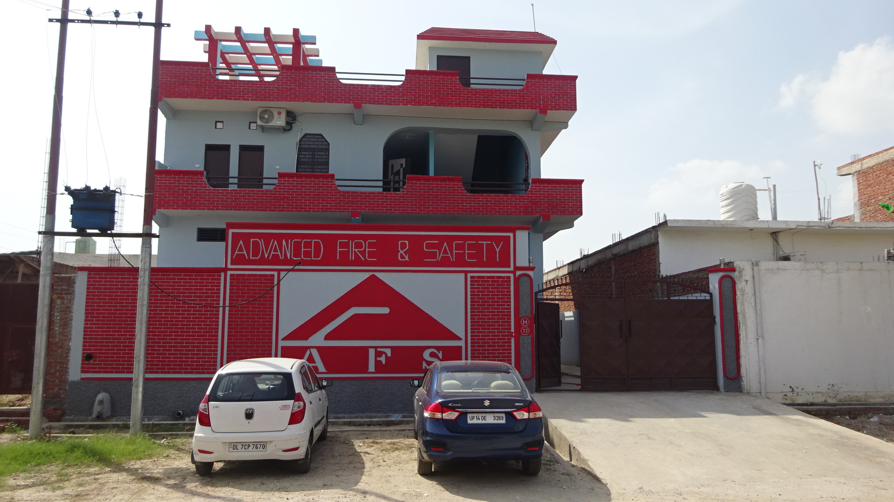
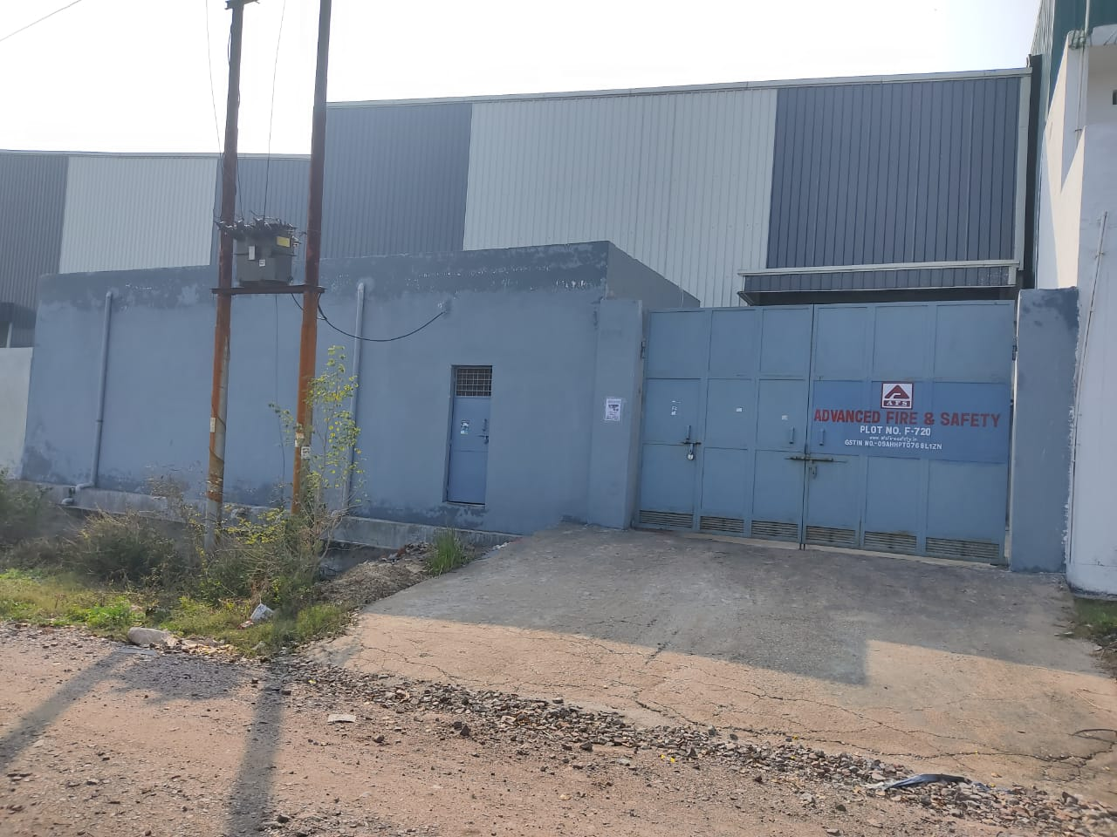
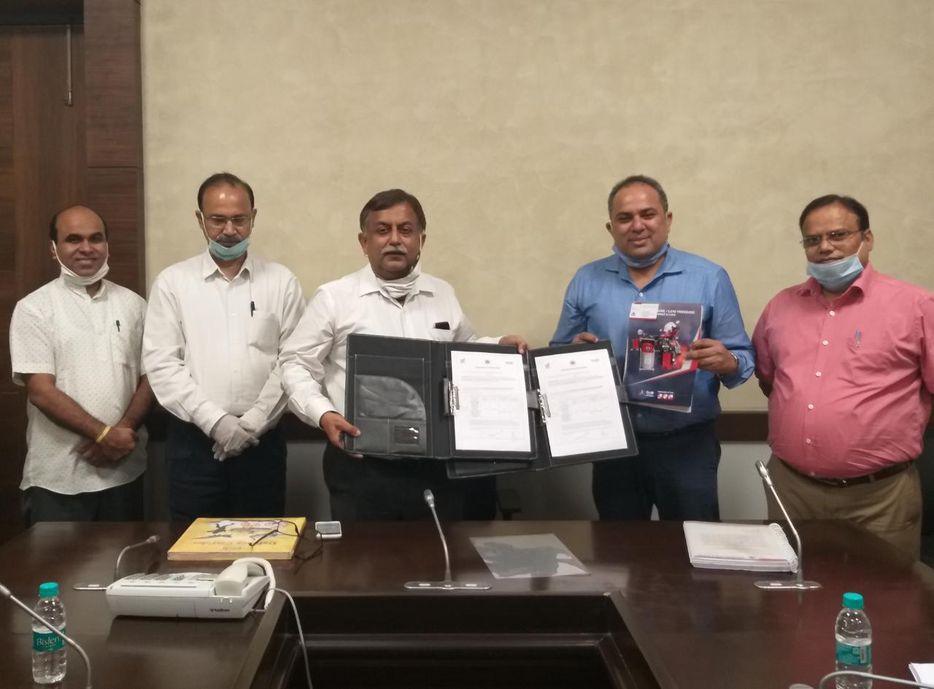
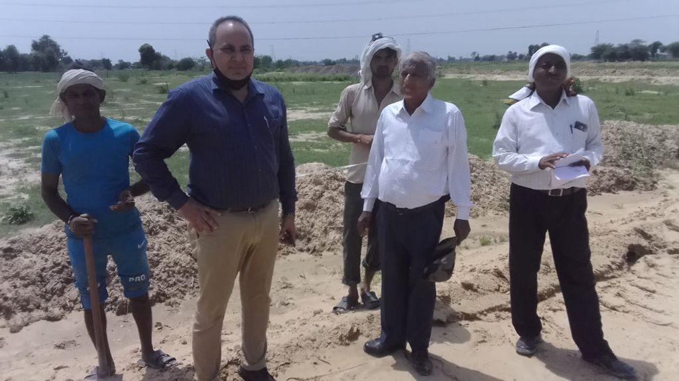
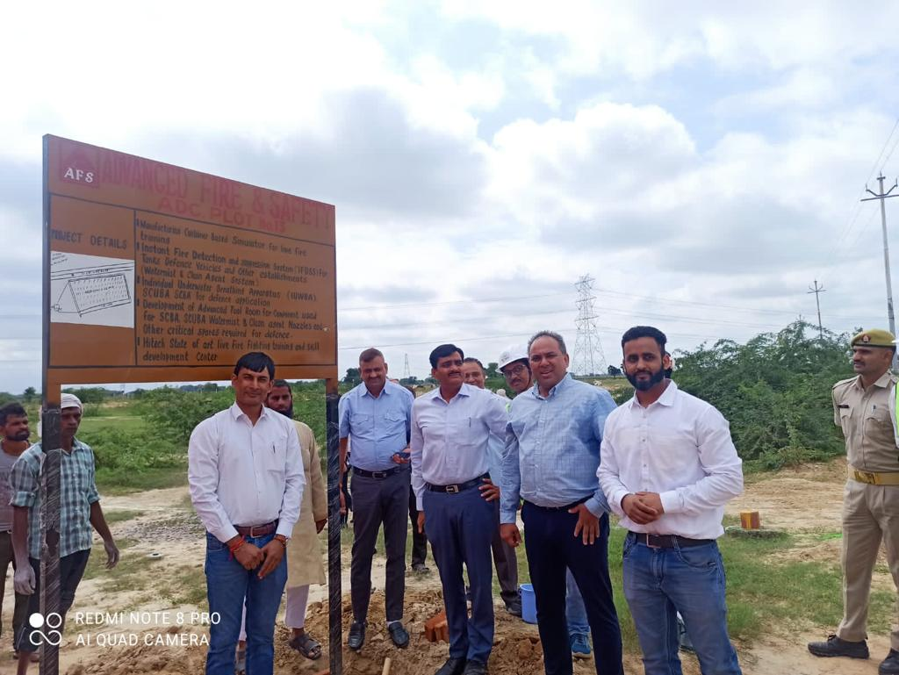
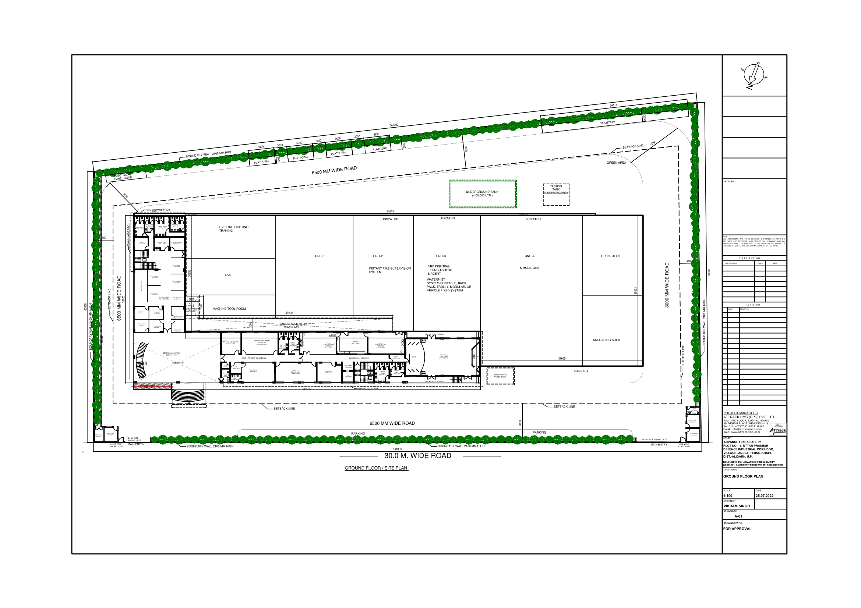
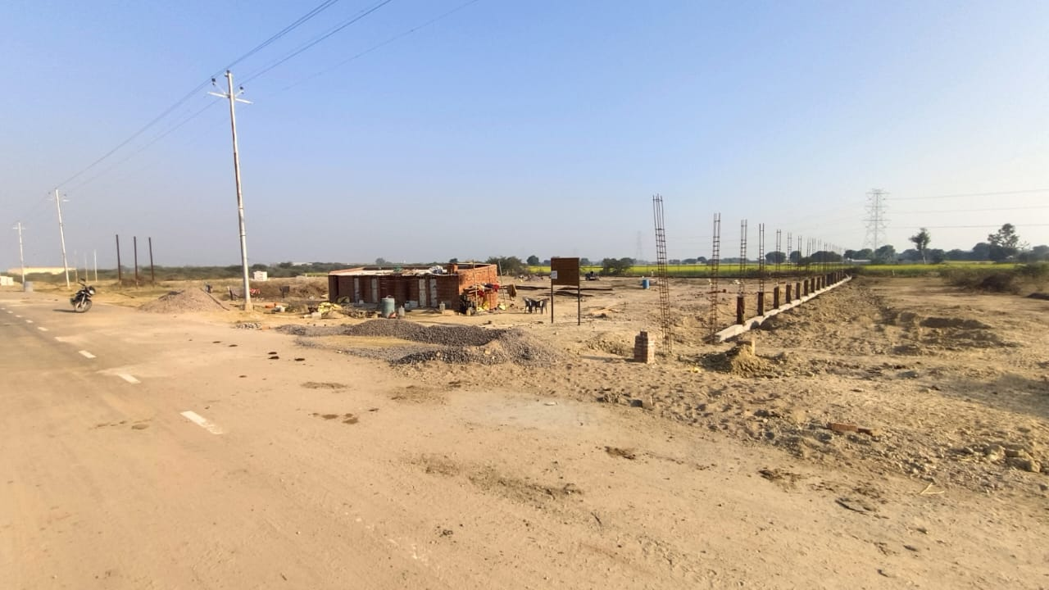
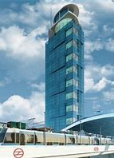
Our EXISTING Manufacturing Facilities
H 77, UPSIDC, MGR Industrial Area, Hapur, UP
F720, UPSIDC, MGR Industrial Area, Hapur, UP
Plot No. 13, Aligarh Defence Corridor, UP
At 1508, 15th Floor "The Iconic Corenthum” Sector 62, Noida
Defence Corridor Aligarh Site Layout Plan
Plot-13, Ongoing Construction Work

Slide 8
Opportunities in SECTOR
State Fire Services
NDRF and SDRF
All PSUs
Defence Services (Army, Navy, Air Force, Paramilitaries, Ordinance Factories and DRDO)
Civil Defence
Indian Railways and Metro Rail
Industrial, Institutional Corporates
Infrastructure Developers
NHAI and other Transportation services
Municipal Corporation
AAI, Shipping, Ports, Refineries and etc
Pharmaceuticals and Automobiles and Fertilizers
NGOs
Exports

Slide 9
Solutions
AFS equipment are found useful from initial to ignition to critical stages of fire while protecting people and property. During fire fighting and post Fire there are several evacuation and rescue operation done by untrained people and trained professionals. Fire-fighting and rescue systems may be divided into four main types:
Extinguishing (initial to ignition to critical stages of fire)
Evacuation (use of respiratory and other rescue equipment to survive from smoke and fire)
Fire Fighting (Blazing stage where professional are required for fire fighting and rescue)
Rescue operation (to save life, minimize damages and also useful in other natural and manmade disasters)
The Advanced Fire & Safety with its team of engineers is highly experienced in designing fire-fighting and rescue systems. We offer adequate solutions and fire training for specific uses, in consideration of all safety requirements, technical know-how and the binding legal standards through following products:
Conventional Fire Extinguishers
Watermist Portable, Backpack, Trolley, Bike and QRV System(Quick Response Vehicle)
Clean Agent based Stickers, Cord and DLP (Direct Low-Pressure System)
Fire Extinguishing Agents (Powders, Foams and Clean Agents)
ELSA, SCBA, TABA, SCUBA and Fire Proximity Suits (respiratory and PPE Products)
Fire Fighting and Disaster rescue Vehicles
Fire other Disaster rescue tools
Breathing Air Gallery and Container Based Fire Training Simulators
Machine and tool room to develop all critical fire fighting spares and accessories to be self reliant.

Slide 10
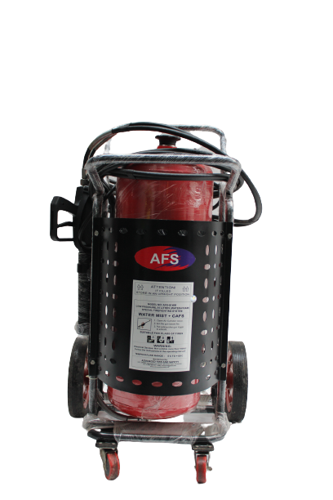
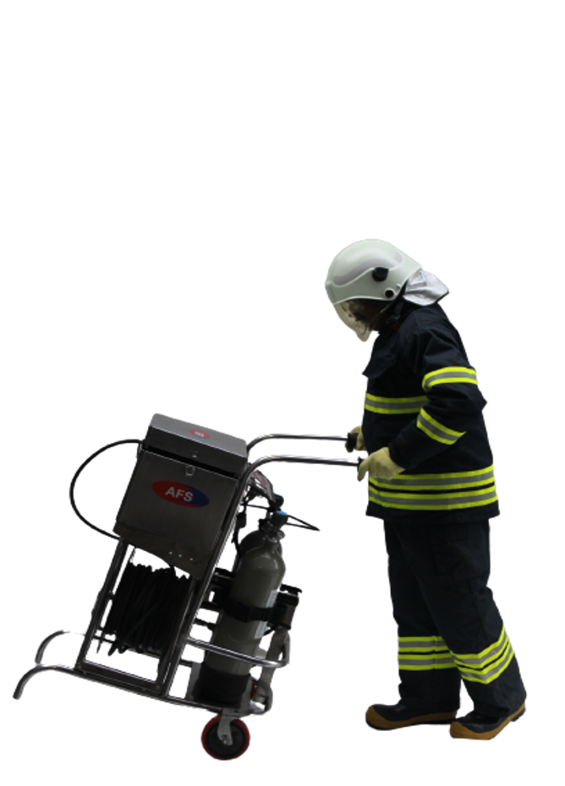
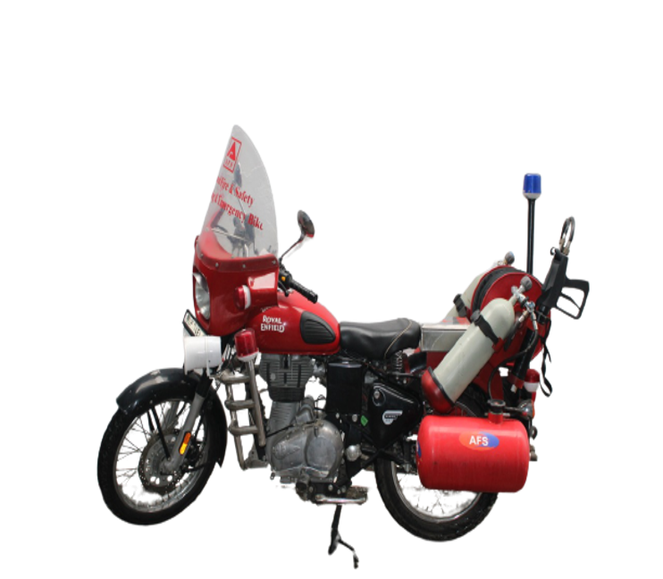
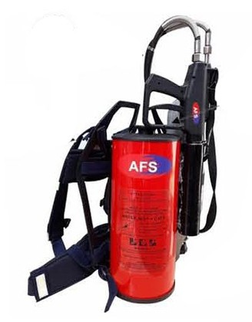
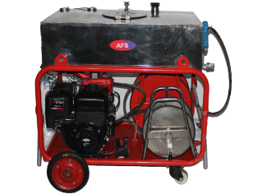
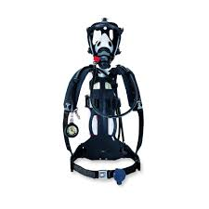
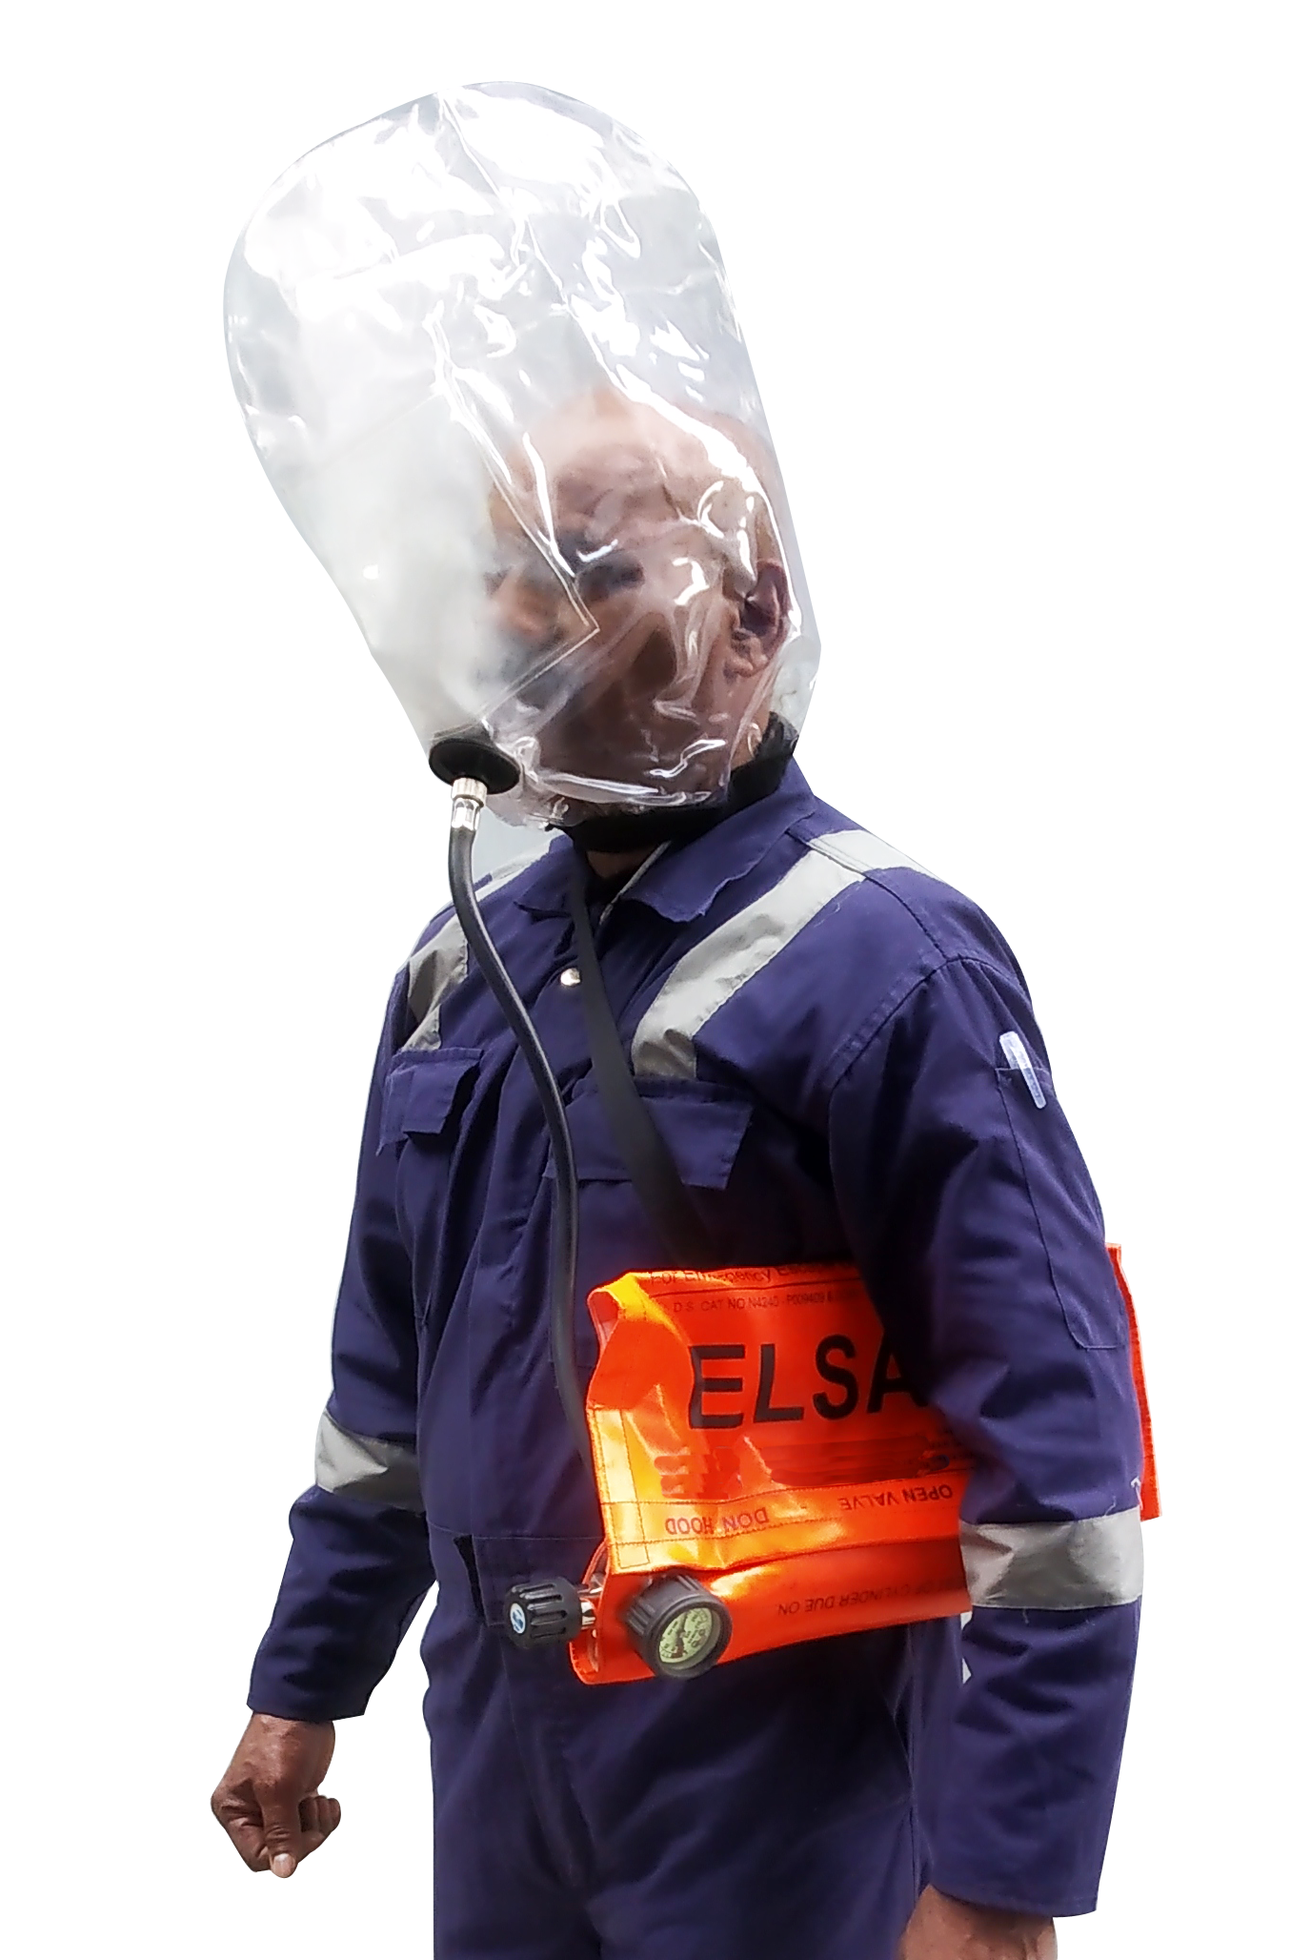

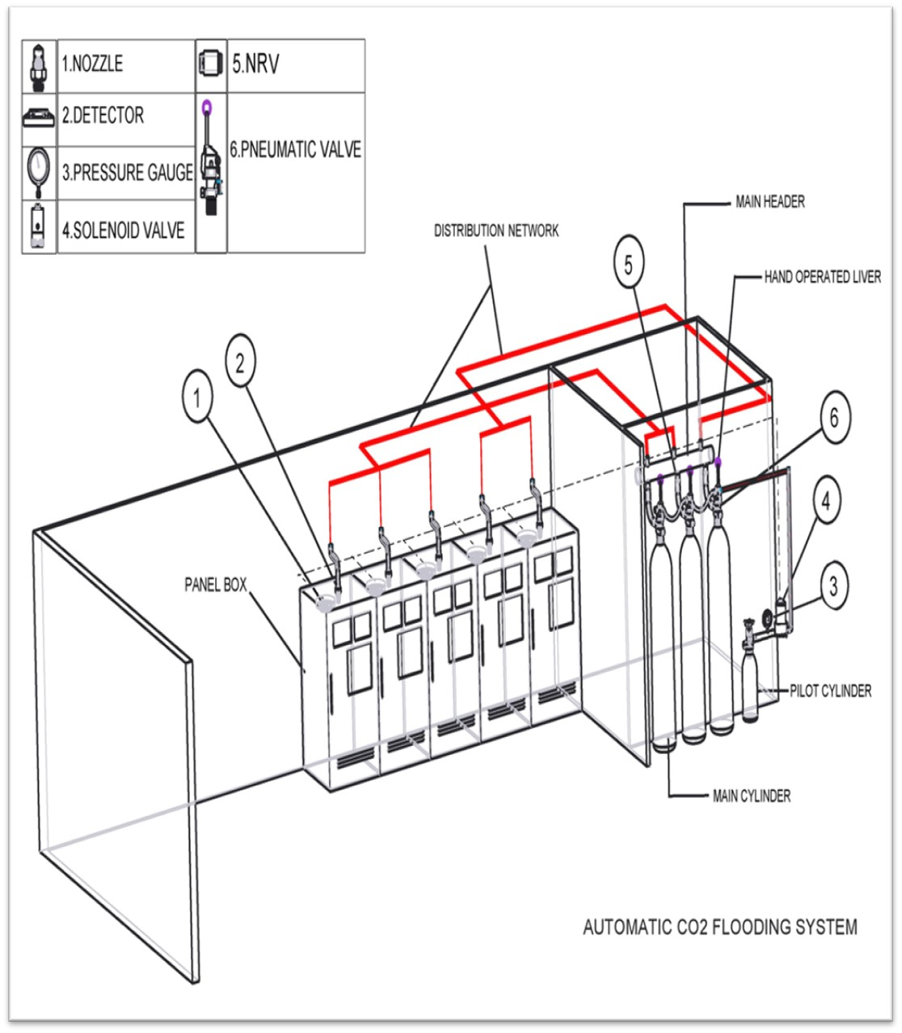

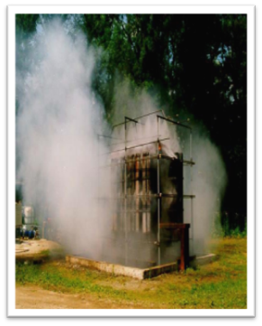
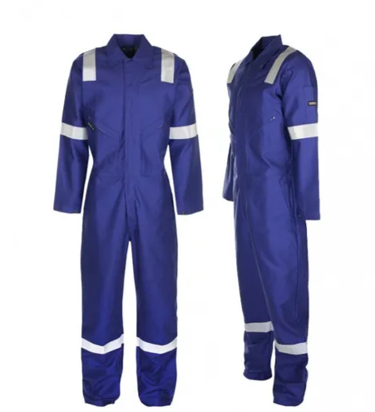
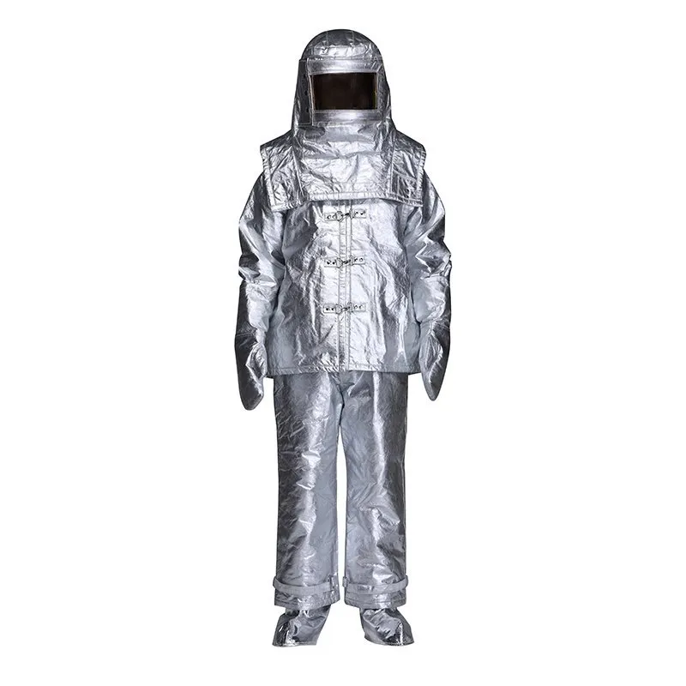
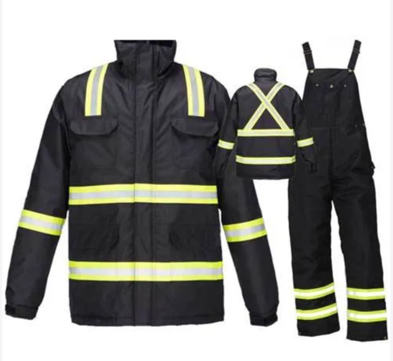
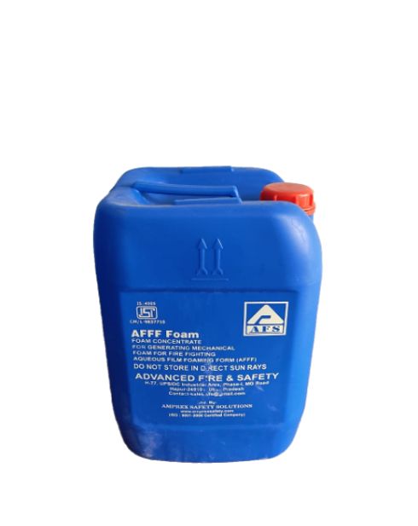
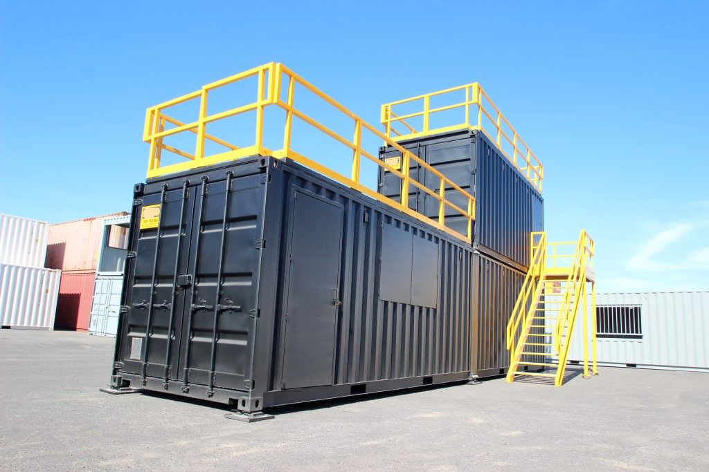
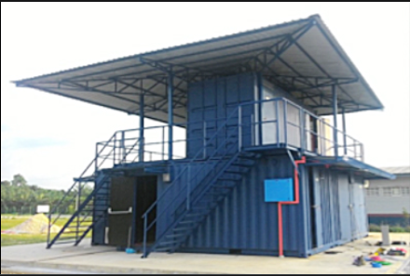
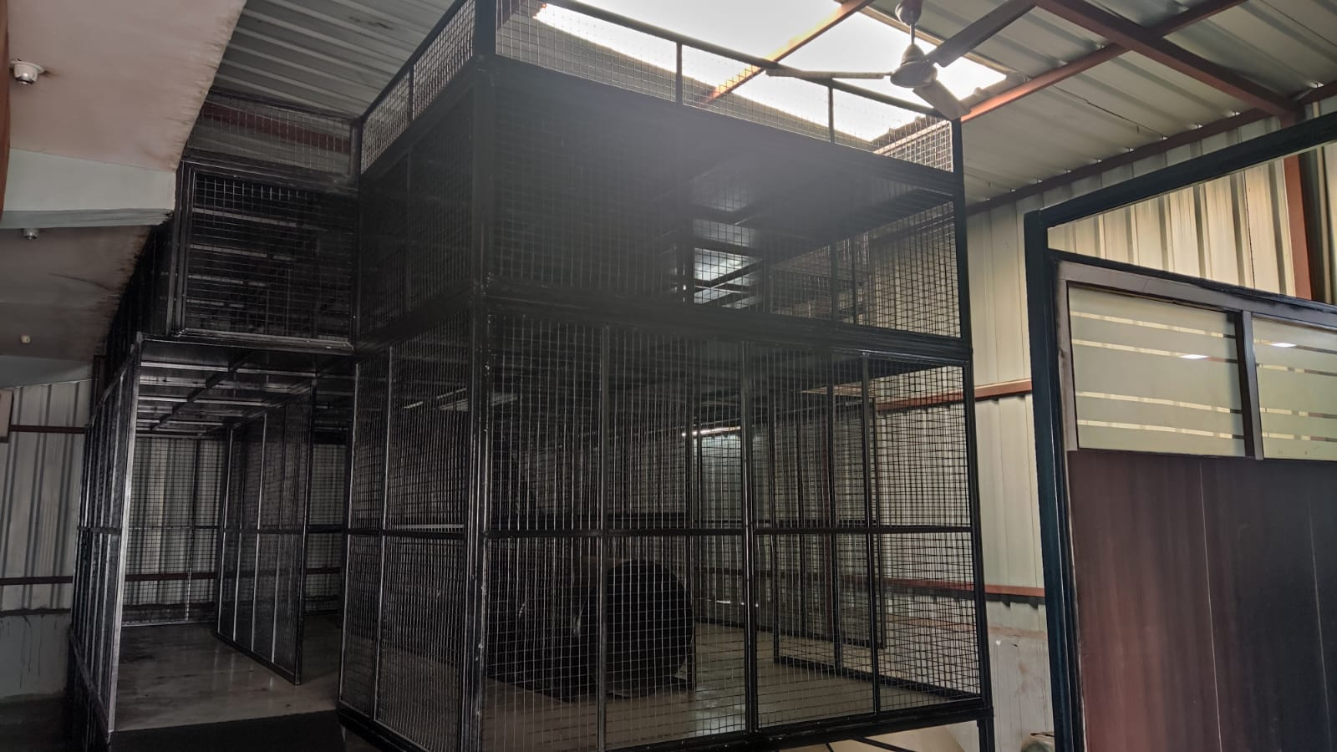
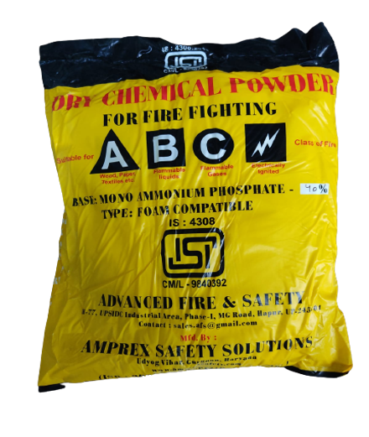
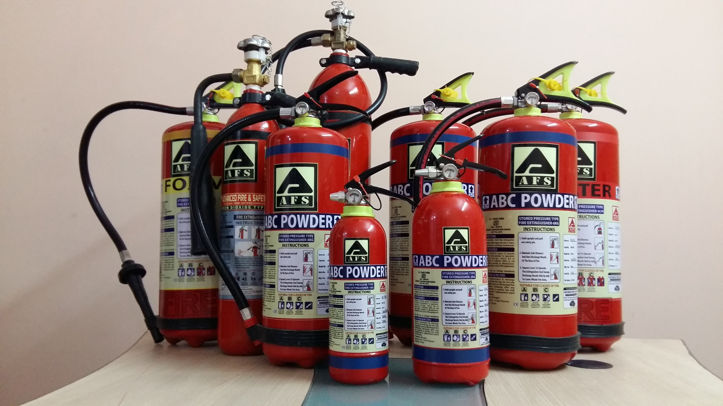
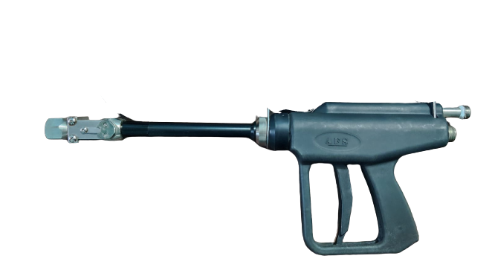
Our Products
High technology water mist system
Respiratory & PPE product
Instant fire suppression system
Simulators & Breathing air gallery
Fire fighting equipment accessories

Slide 11
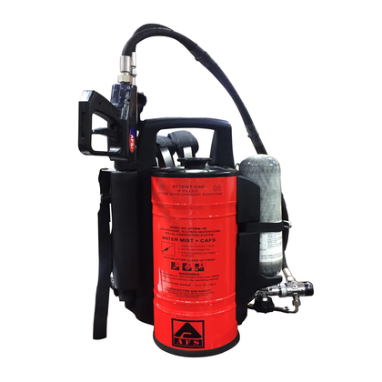
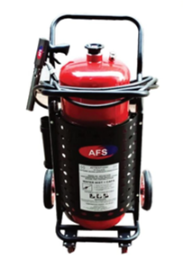
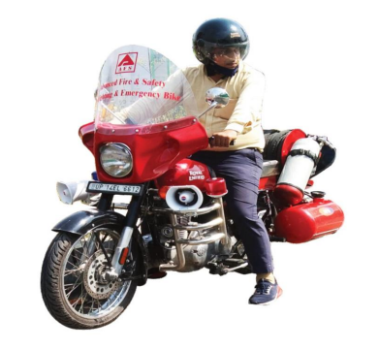
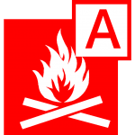
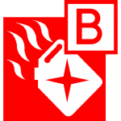


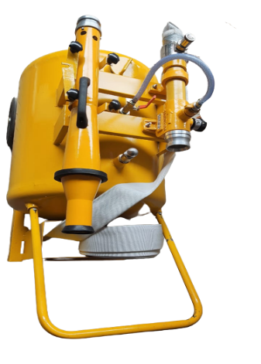
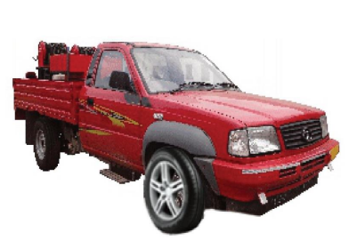
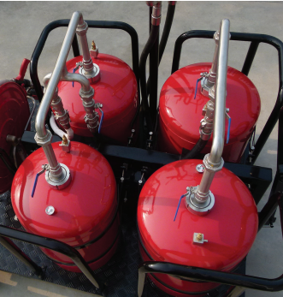
Water Mist/CAF Type Fire Extinguishers
Water Mist type fire extinguisher contains only soft water.
Which is break down into tiny particle with the help of special
purpose nozzle
Size/Capacity available -9Litre/10 Litre/trolley
/Fixed System
50L Trolley
Back pack
Mobile Foam Trolley Unit 200 litter
AFS POWER QUAD WATER MIST SYSTEM (LOW PRESSURE)
200L trolley
WATERMIST & CAF BASED 550 L SMALL VEHCILE MOUNTED

Slide 12
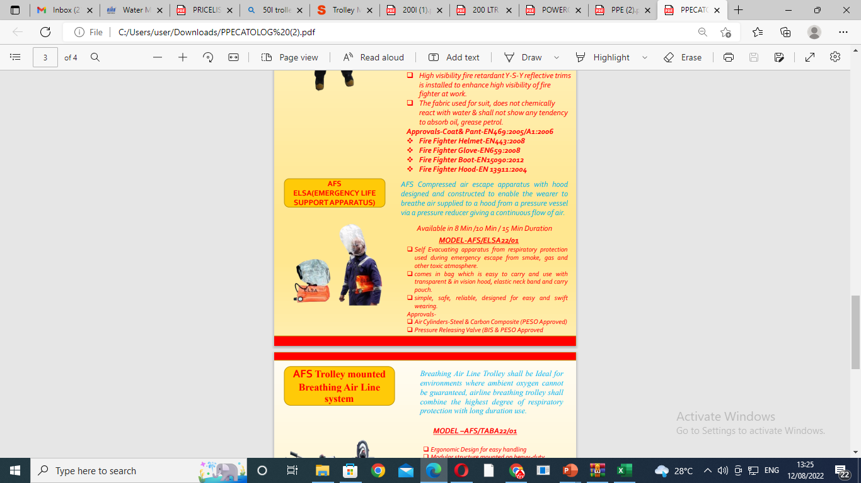
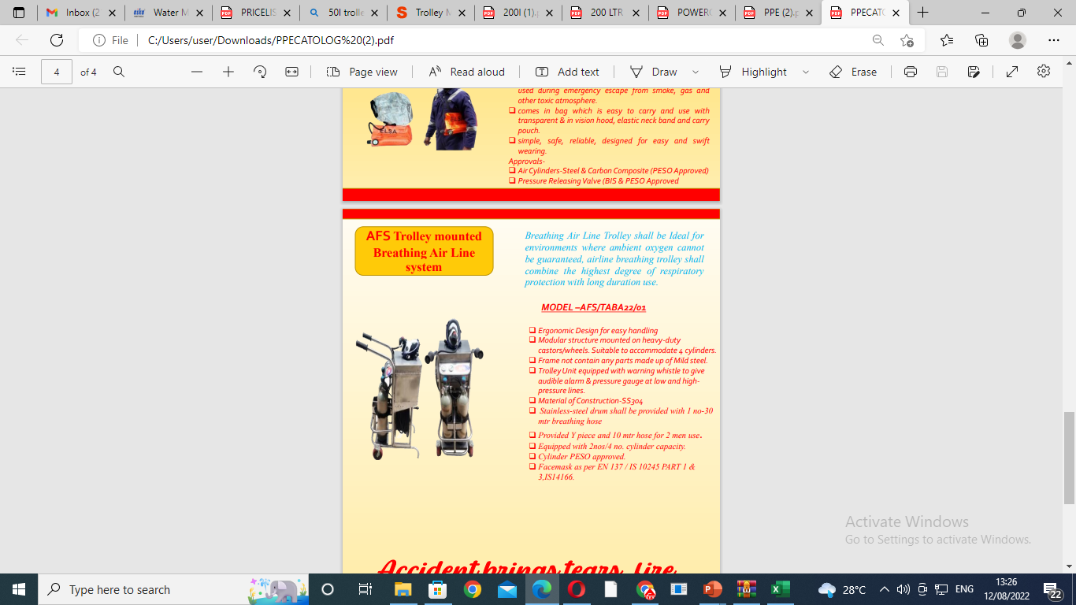
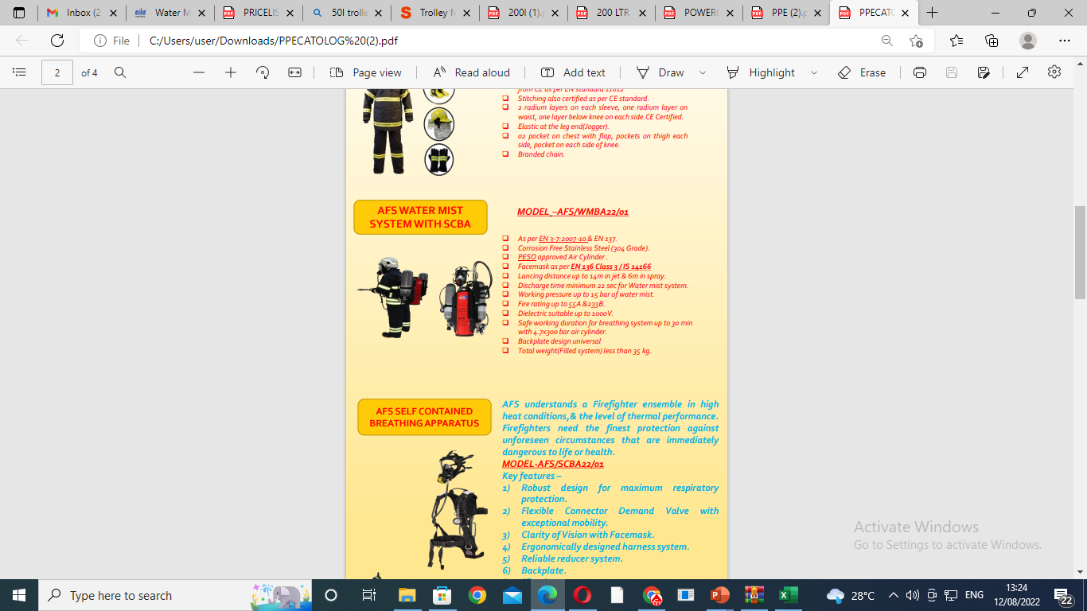
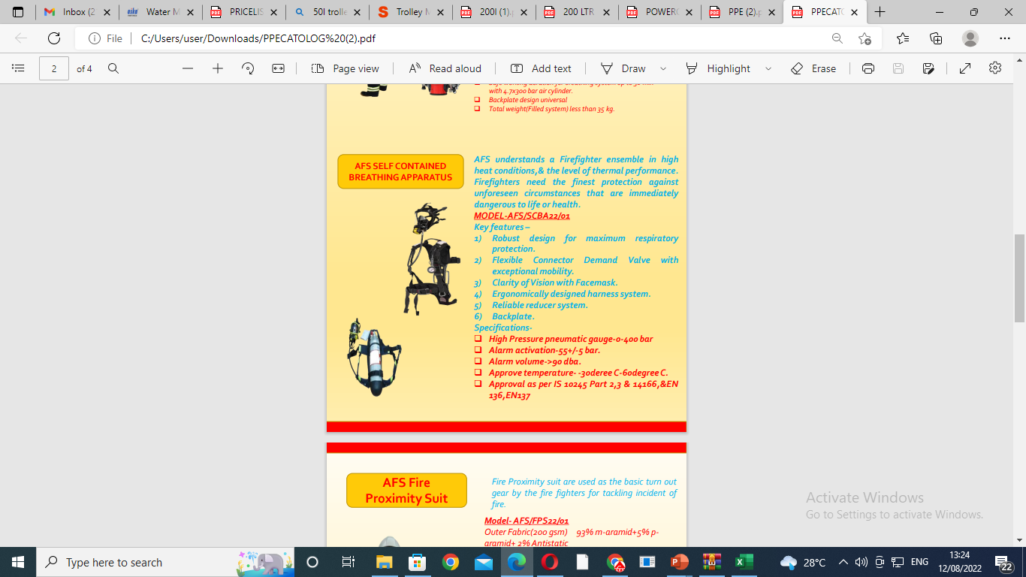
AFS RESPIRATORY & PPE PRODUCTS

Slide 13
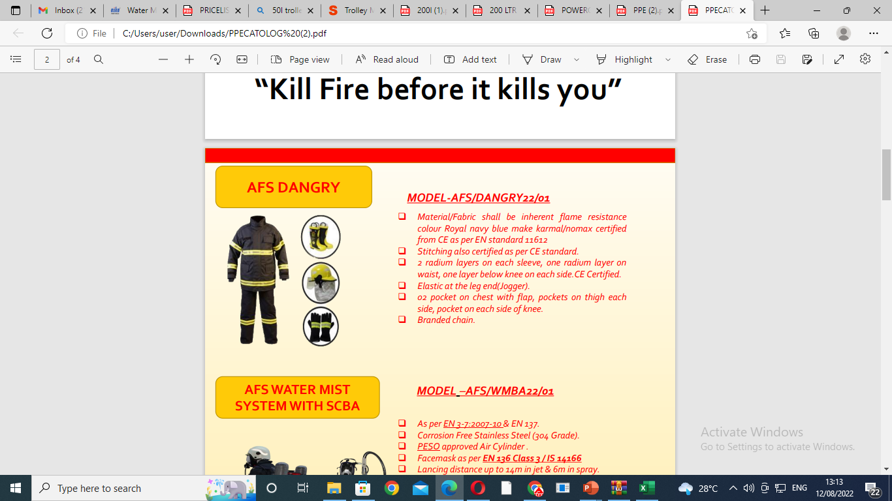
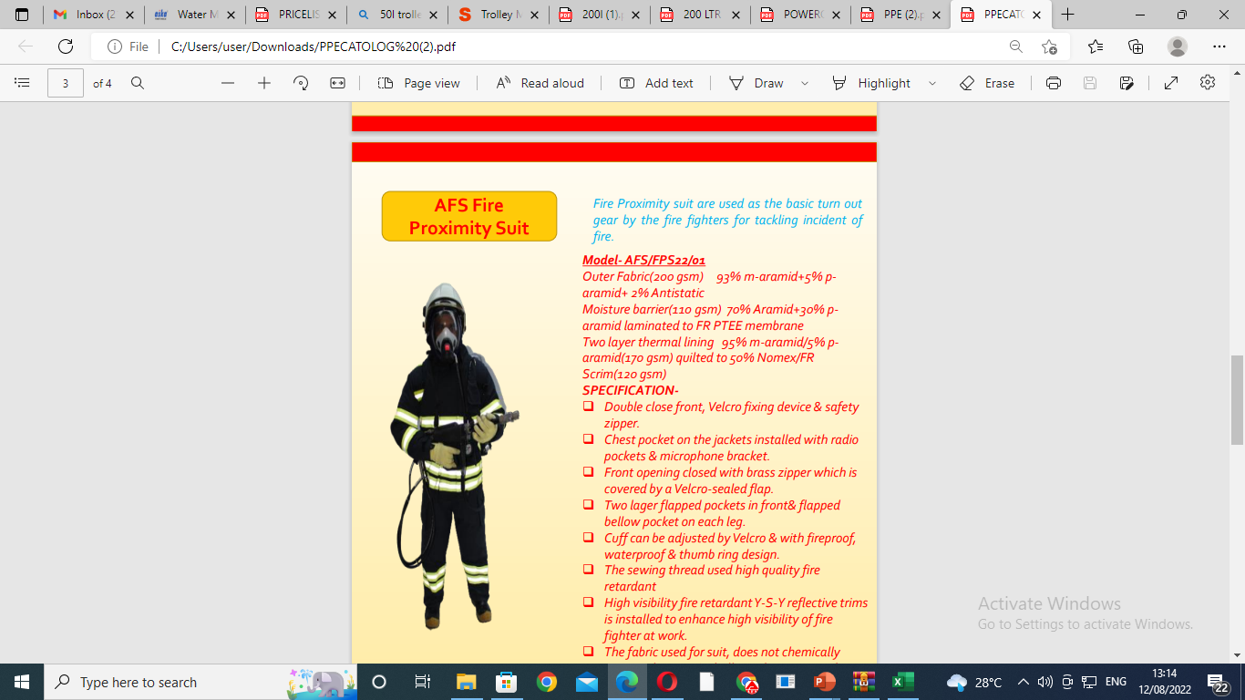
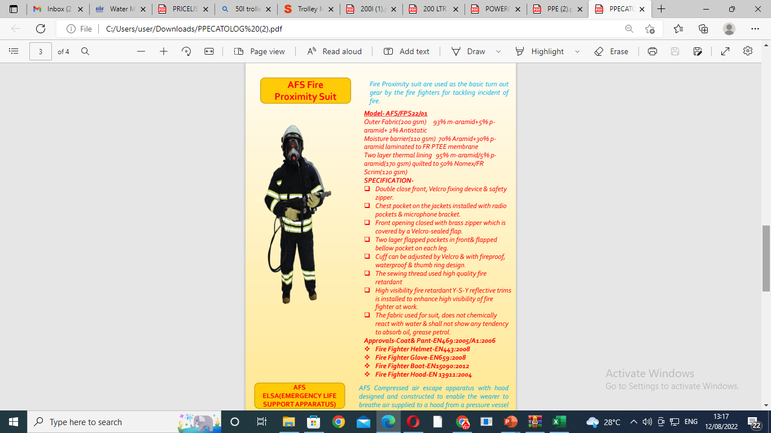
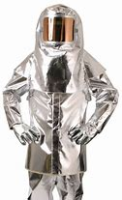
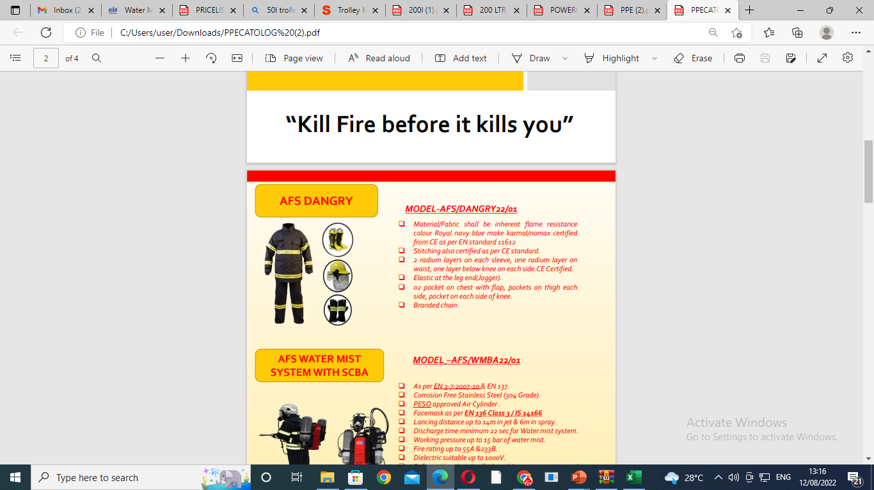
AFS RESPIRATORY & PPE PRODUCTS
heat resistant suit provides protection against heat radiated to the temperatures of up to 1200°C

Slide 14
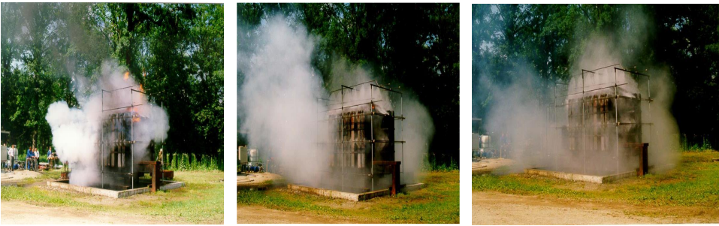
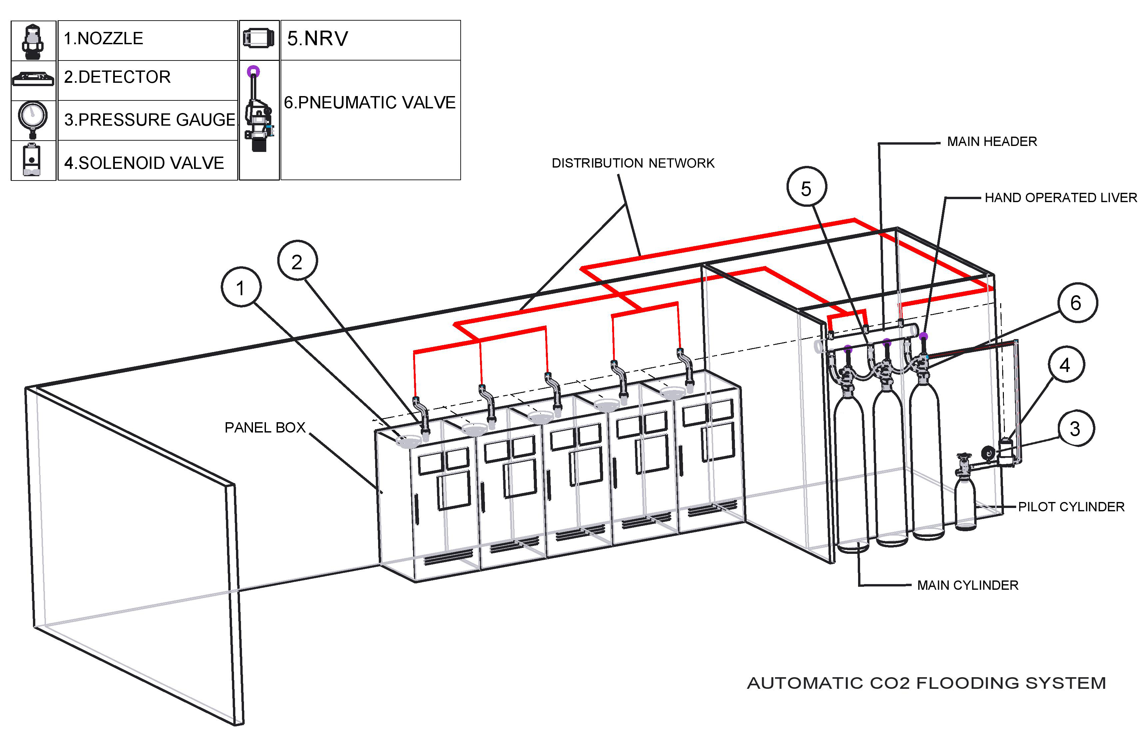


Instant fire detection & suppression system and Water mist & Clean Agent system
Sticker
Tube based fire suppression system
Cord
Based on latest nano technology can suppress the fire in the initial stage only. The material is available in multi options such as PAD for flooring, wire & cable coverings, cover & tape to be applied on small places. The fire suppressant is to extinguish a fire in initial phase by spraying the extinguishing agent stored in the form of micro-micro capsules at a specific temperature. Having wide range of application-
Covering of all remote places on board.
Covering of main line cable in inaccessible area.
Covering of vital machinery.
Fire suppressant pad to be installed in distribution panel, battery breaker & switch board
Area –ships,tunnels,aersospace,base camp etc

Slide 15
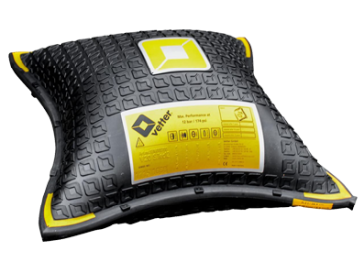
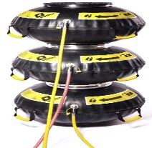
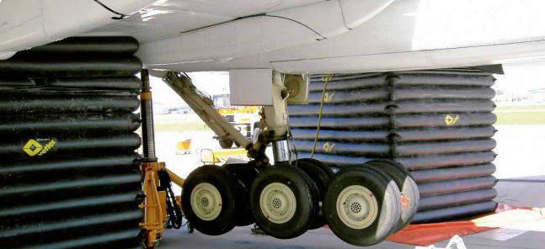
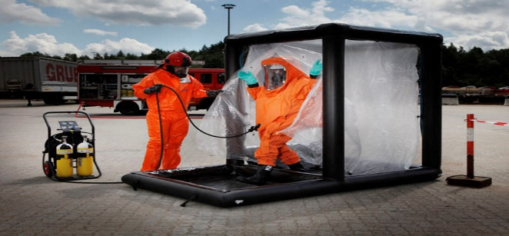






Rescue equipment
Lifting Bag
Connectable Lifting Bag
Aircraft Lifting Bag
Decontamination Chambers
Rescue Paths
Tents
SAFETY CUSHION / JUMP CUSHION
Leak Sealing

Slide 16

Rescue Tools

Slide 17





Breathing Air Compressors
Portable Compressors:
Portable Breathing Air Compressor with rate of Free Air Delivery @ 100 lpm , 140 lpm.The compact classic among mobile breathing air compressors
Stationary High pressure Breathing Air Compressors. Used for filling high pressure cylinder . Comes in the capacity more than 200lpm
IE 100
JUNIOR II
MINI-VERTICUS
Stationary Compressors
Safety Containment Filling Stations
IE 250

Slide 18




Simulators, Fie Fighting Vehicles and Breathing AIR Gallery
The defence personal & fire fighter during the training in the containers are confronted with real flames, extreme heat, high humidity, severely restricted visibility, and thick smoke. This allows them to train for an emergency as realistically as possible

Slide 19

Hitech state of art live fire fighting training & skill development centre.
Hitech training centre with latest technology equipped to provide best training to defence officials and International fire fighting officials

Slide 20





Advanced tool room for component used for SCBA, SCUBA, Water mist & Clean Agent Nozzles & other critical spares required for defence applications.

Slide 21
Impacts
The market demand for alternative new technologies and systems are increasing in the firefighting, rescue, and fire training industry. Discussion on how rapid-fire safety system can be adopted for the emerging fire hazards worldwide.
Fire Service Concerns/Mitigation Strategies:
New technologies are being introduced into the consumer environment faster than ever but many of the firefighting tactics used today in our country are based on the past hundred years of firefighting experience. Whereas the fire service is on the front lines of environmental protection in the United States and several European countries.
Regulatory Context
As new technologies, codes and standards addressing safety will need to stay at the forefront of the industry for maintaining safe and reliable fire and rescue operations worldwide.
Fire Safety is a Sustainable Practice
During a fire incident building materials are damaged, property is lost, water is wasted, and pollutants are released into the environment through the air and water. The environmental impact of the fire depends on the size and severity of the event.
Risk Balance
Each year new products, systems, and materials are developed to try and reduce the size, severity, and number of fire events. While these new solutions might protect against one risk, they could be creating a new risk of their own.
Future
All users additional focus on the issue of sustainability and fire safety is needed. Building designers, architects, engineers and members of the fire service need to be aware of the hazards associated with certain sustainable features.
AFS Cloud Fire & Rescue Equipment Services is a platform which will be launched soon in country and it would be operated through providing on site servicing and assistance for any type of Firefighting and Rescue System servicing and training on site to strengthen the industrial supervision and precisely to control the constantly increased Fire Safety Systems and equipment ease of operation and as well as seeking an effective approach to solve the problem of expensive or being too technical.

Slide 22
Competition Analysis
Description | ADVANCED FIRE & SAFETY | Draeger | MSA | Honeywell | Joseph Lisle Dynamics | Vijay Sabre
Country of Origin | India | Germany | USA | USA/China | India | India
MANUFACTURING FACILITIES | 100% made in India | 100% in Germany & USA | 100% in USA | 100% in China | Almost all parts from China and labelling done in India | Almost all parts from China and labelling done in India
TESTING FACILITIES | Moving towards achieving 100% in house (planed) | In USA except for minor servicing centre | USA | China | Partially Servicing or else critical parts replaced | Partially Servicing or else critical parts replaced
PRICE | Competitive | Higher | High | High | Average | Average

Slide 23
Project Plan & Funding Requirement
Filtration based Breathing Apparatus
1.SCBA & SCUBA with light weight cylinder
2.ELSA
3.Airline trolley
4.Powered Air Purifying Apparatus
Funding Requirement
Approx. Rs. 4 Crores for setting up testing labs with NABL accreditation, Dies, CNC and other relevant machines for 100% indigenised spares and accessories, testing in international lab for international certification to compete with international competition.
Indigenous Fire Training Container based Simulators
Breathing Air Gallery
Instant Fire Suppression Systems
State of art Fire Training and testing facility in India.
Rescue Tools and Breathing Air Compressors
Funding Requirement
Approx Rs. 8 Crores for setting up Indigenised manufacturing facility for container simulator, BA Set Gallery, Instant Suppression System, Training facility, Testing labs with NABL accreditation, rescue cutters, spreaders, Powerpacks, Ramset's, combi tools and High Pressure Air compressor for filling breathing air at par with EN, NFPA and other international standard along with certification to compete with international competition.

Slide 24
Marketing plan
Asia-Pacific is the largest region in fire safety equipment revenue. It accounted for a 28.7% share of revenue in 2021 and will remain the leading region in revenue till 2027. The analyst notes that the Middle East & Africa, and Latin America have the fastest growing fire safety equipment revenue. Robust economic growth, development of fire safety regulations, and upcoming construction activities in these regions will lead to a CAGR of 7.6% and 8.1%, respectively.
North America and Europe are relatively mature regions in the fire safety equipment market, but these are hubs for innovation in fire safety advancement. The analyst identifies the growth opportunities in fire safety equipment to integrate sustainability, digital applications and solutions, and robotics themes.
AFS gearing up its marketing plan keeping worldwide business potential (local and Exports) from our land,
We are working and soon start implementing following: These include:
Creating a Facebook business page
Setting our ad goals
Determining the objective of our campaign
Selecting our target customers worldwide.
Setting our spending limit
Deciding the look and feel of our ad
Launching our ad
Advanced Fire & Safety dedicatedly working on Positioning Strategy, Cost and pricing, Sales and After sale service strategies, international standards and government approvals for product, 100% indigenized and reliable products, all Inhouse dedicated testing facilities at par with international standards and offerings, PESO and all relevant local approvals for plant and testing equipment and world-class inhouse Training facilities inhouse.

Slide 25
Marketing strategy
We at AFS has outlined the marketing strategy, promotional, and advertising activities planned for the period 2023 to 2025 by setting up following tools:
AFS Marketing objectives of the business: We are trying to make our objectives attainable and measurable goals associated with SMART, which stands for Specific, Measurable, Attainable, Relevant, and Time-bound.
Current business marketing positioning: An analysis of the current state of the organization concerning its marketing positioning.
Market research: Detailed research about current market trends, customer needs, industry sales volumes, and expected direction.
Setting up the outline of the business target market by clearly understanding the business demographics.
Marketing activities: A list of any actions concerning marketing goals that are scheduled for the period and the indicated timelines.
Key performance indicators (KPIs), Marketing Mix, Competition, Marketing strategies, Marketing Budgets and Monitoring ad performance mechanism to be tracked along with changes in the environment may necessitate a review of plans, projections, strategies, and targets. Therefore, a formal periodical review – such as monthly or quarterly – may need to be in place. This may mean preparing an annual marketing plan but reviewing the plan quarterly to keep targets and plans aligned closely to environmental changes. It goes without saying that plans are as good as their feasibility to succeed in the given environment.

Slide 26
SALES STRATEGY
AFS working hard towards building a healthy, high performance sales team on three pillars — compensation, competition, and camaraderie to inspire our sales team to maintain the highest level of productivity and performance regardless of circumstance.
The 6-step sales pipeline process being followed by AFS is SPANCO for
Suspecting
Prospecting.
Analysis
Negotiation
Closing
Order
We are investing in design of BA set Gallery, Container based Fire Fighting simulators, improving the website for dynamic exposer, soon presenting online catalogues, collecting leads to facilitate an ecosystem, adequately utilizing search engine optimization, preparing and distributing customized documentations, seriously working on increasing our PR efforts by using social media and are tying our best to develop a system to take full advantage of our company websites to leap ahead of the competition to have the significant advantages. AFS also dedicated to support the sales tam and customers with a great website to enjoy customer loyalty and increased sales.

Slide 28
AFS Business Model:
AFS customer value proposition and the profit formula define value for the customer and the company, respectively, key resources and key processes describe how that value will be delivered to both the customer and the company
Customer value proposition (CVP): Once we understand the job and all its dimensions, including the full process for how to get it done, we can design the offering.
Profit formula: The profit formula is the blueprint that defines how the company creates value for itself while providing value to the customer. It consists of the following:
Revenue model: price x volume
Cost structure: direct costs, indirect costs, economies of scale. Cost structure will be predominantly driven by the cost of the key resources required by the business model.
Margin model: given the expected volume and cost structure, the contribution needed from each transaction to achieve desired profits.
Resource velocity: how fast we need to turn over inventory, fixed assets, and other assets—and, overall, how well we need to utilize resources—to support our expected volume and achieve our anticipated profits.
Key resources. The key resources are assets such as the people, technology, products, facilities, equipment, channels, and brand required to deliver the value proposition to the targeted customer.
Key processes
Successful companies have operational and managerial processes that allow them to deliver value in a way they can successfully repeat and increase in scale. These may include such recurrent tasks as training, development, manufacturing, budgeting, planning, sales, and service. Key processes also include a company’s rules, metrics, and norms.

Slide 29
AFS Market Analysis
We are under process of market analysis by conducting quantitative and qualitative assessment of the market. We are seriously considering the size of the market both in volume and in value, the various customer segments and buying patterns, the competition, and the economic environment in terms of barriers to entry and regulation. We are formulating our market strategy considering following:
Demographics and Segmentation
Target Market
Market Need
Competition
Barriers to Entry
Regulation

Slide 30
AFS Competitive Analysis - Hypothetical
Company | Competitor 1 (MNC) | Competitor 2 (Small Indian Manufacturer) | Competitor 3 (MNC Distriutor) | AFS: Manufacturer, Distribution, Direct Sales and Exports
Revenues | INR 75,00,000,00.00 | INR 8,00,000,00.00 | INR 35,00,500,00.00 | INR 15,00,000,00.00
Nb. employees | 20 | 15 | 12 | 28
Size | Offices: Mumbai & Delhi Works: Vadodara | Office & Works: Pune | Offices: Kolkata, Delhi, Mumbai and a few resident Managers in major cities | Works: Hapur (2units), Aligarh (upcoming), Offices: Delhi and few resident managers in major cities.
Price | Very High | Low | High | Competative
Quality | Very Good | Low | Average | Good and working towards better
Choice | Very Large | Average | large | large

Slide 31

Putting ourself in an investor shoes. We are dedicatedly working to deliver a target return to the investors which implies both vizaviz in de-risking the investment earlier (x-Amount) or investing in opportunities which offer substantial upside potential (i.e. huge market size).
The SOM and SAM will help de-risking the investment while the TAM enables to assess the upside potential.
The Serviceable Obtainable Market is AFS short term target and therefore its matters the most if we could succeed on a fraction of the local market chances are higher that we will capture a large part of the global market.
We expect our investor to have a realistic objective and must judge us on our ability to deliver the objective.
TAM SAM SOM have different purposes: SOM indicates the short term sales potential, SOM / SAM the target market share, and TAM the potential at scale. All play an important role in assessing an investment opportunity and the focus should really be on getting the most accurate numbers rather than the biggest possible numbers.

Slide 32
AFS step-by-step guideline (being followed currently) to build our corporate financial plan:
Setting financial goals
Creating a budget
Planning for taxes
Building an emergency fund
Drafting the outlines to manage debt
Protecting with insurance
Plan for retirement
Currently Seeking Investment beyond 12 Crores
In short, while it's never too late to get started, the very best time to start financial planning is as soon as we begin earning an income. The sooner we understand our finances and make empowered decisions about where our money is going, the more time we'll have to save and invest.

Slide 33
Financial analysis for infrastructure
Total cost of the project-
Cost of the plot - 75L
Building & Structures - 350L
Machinery & Equipment’s - 450L
Misc. Fixed Asset - 150L
Pre-liminary and Pre-operative expenses - 100L
Contingencies/Price Escalation - 75L
Margin Money for working capital - 50L
Sources of Finance –
Term loan from bank (as on date) - 200L
Promoters Contribution + Unsecured loan from friend - 250L
Govt scheme for MSME -
Probable required invest - 800L

Slide 34
TABISH FEHRI
(CEO Cum Gr Managing Director)
Chetan Kumar
(EA to Director)
Rajesh Sharma
(CFO)
Durga Prasad
(Accounts)
Ankit Singh
(PD & QC head)
Vishal karmuthail
(Sales & Mark Head)
Siraj Saifi
(Project head)
Drawing and Design
Executive
Aquid
(QC Executive)
Satish Kumar
(Back Office, GeM & eTender Sales)
Mahesh
(Sr. Project Technician)
Rakesh Kr. Bora
(Factory Supervisor & Logistics)
Yash Bharadwaj
(Service Technician)
Purshotam M Selokar
(Sr. Technician & 2nd Unit Head)
Dharmendra
(Distribution, eTender and GeM Sales)
Nishu Sisodia
(Service Technician)
Mosin
(Technician)
Sachin Kumar
(Technician)

Slide 35






COMPANY CREDENTIALS
Registration & Approvals
1 | BIS CERTIFICATION
2 | NSIC REGISTRATION
3 | ISO 9001:2005
4 | ISO 10003:2005
5 | OHSAS 18001:2007
6 | PED ISO CERTIFIED
7 | PESO CERTIFIED UNIT
8 | UDHYOG ADHAR/MSME
9 | UP SHOP ESTABLISHMENT
10 | IIA Membership
11 | CQA (APPLIED FOR)

Slide 36



ADVANCED FIRE & SAFETY
DEFENCE CORRIDOR – ALIGARH NODE – PLOT No. 13
Fire Fighting Innovation & Design, Need of Necessity for “ATMANIRBHAR BHARAT”

Slide 37
AFS MISSION STATEMENT
Our purpose of innovation is to create a new value for our country, and we should come out from consuming market to producing and innovation market following a mandate of
“ATMANIRBHAR BHARAT”
THANKS
TABISH FEHRI
Mob:+91-9990703782
www.afsfiresafety.in
sales.afs@gmail.com

